Slide 1



Defence
Industry
Indonesia
General Information

Slide 2







Vision
To become a national defence industry that is advanced, strong, independent, competitive, and leading in the global market
About Us
Mission
Building a national innovation collaboration
Building technological independence and increasing company competitivenes
Becoma part of the global supply chain by developing global strategic partnership
Serves as the main driving force for the development of the domestic industrial ecosystem
Defence Industry Indonesia also know as DEFEND ID is a Holding of state-owned companies in Indonesia, which consists of five companies specializing in
Target
The Top
Global Defence Company
Electronics Systems
Energetic Materials
Aerospace
Platform
Naval Platform, Submarine &
Shipbuilding
Land Platform, weapon, munition & heavy equipment
50

Slide 3
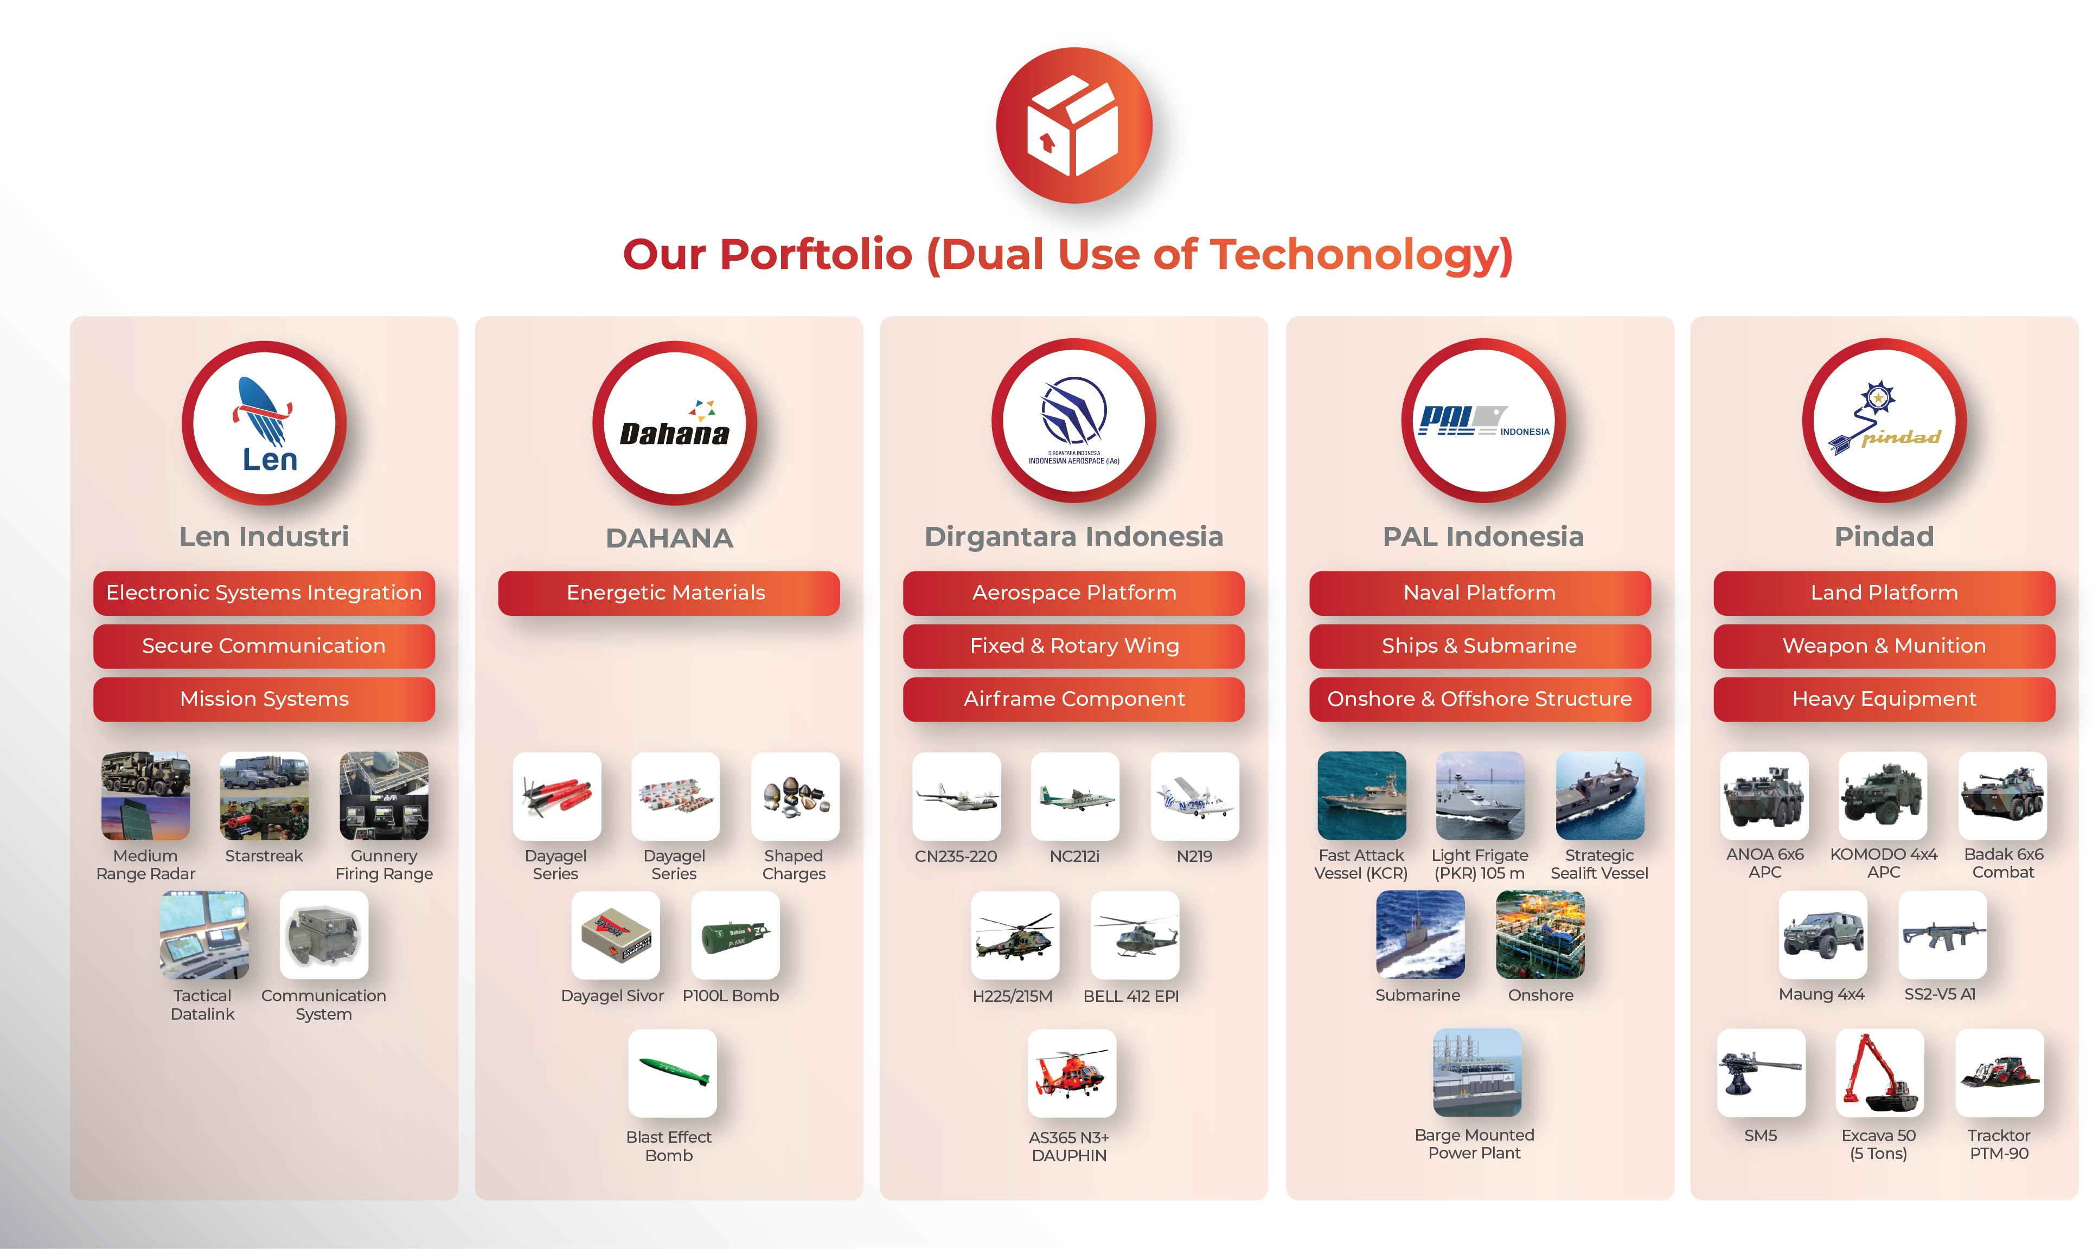

Slide 4
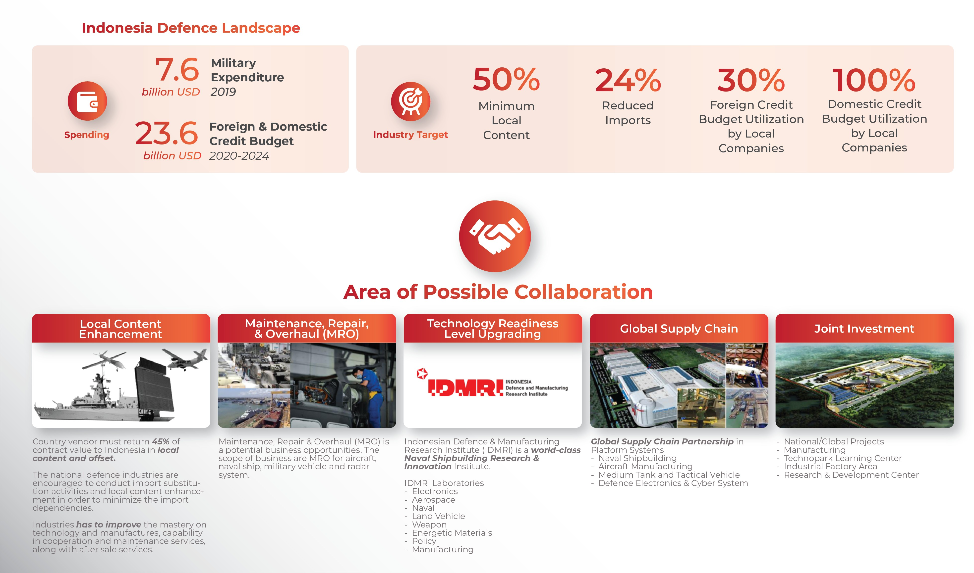
Maintenance, Repair & Overhaul (MRO) business is one of the high potential business opportunities such as MRO for aircraft, naval ship, military vehicle and radar system.
Currently there are business collaboration with AMMROC for MRO aircraft, component, modification and spare
Indonesia has a military power ranked 16 in the world by globalfirepower report. this is one of the references for the magnitude of Indonesia's military strength.

Slide 5
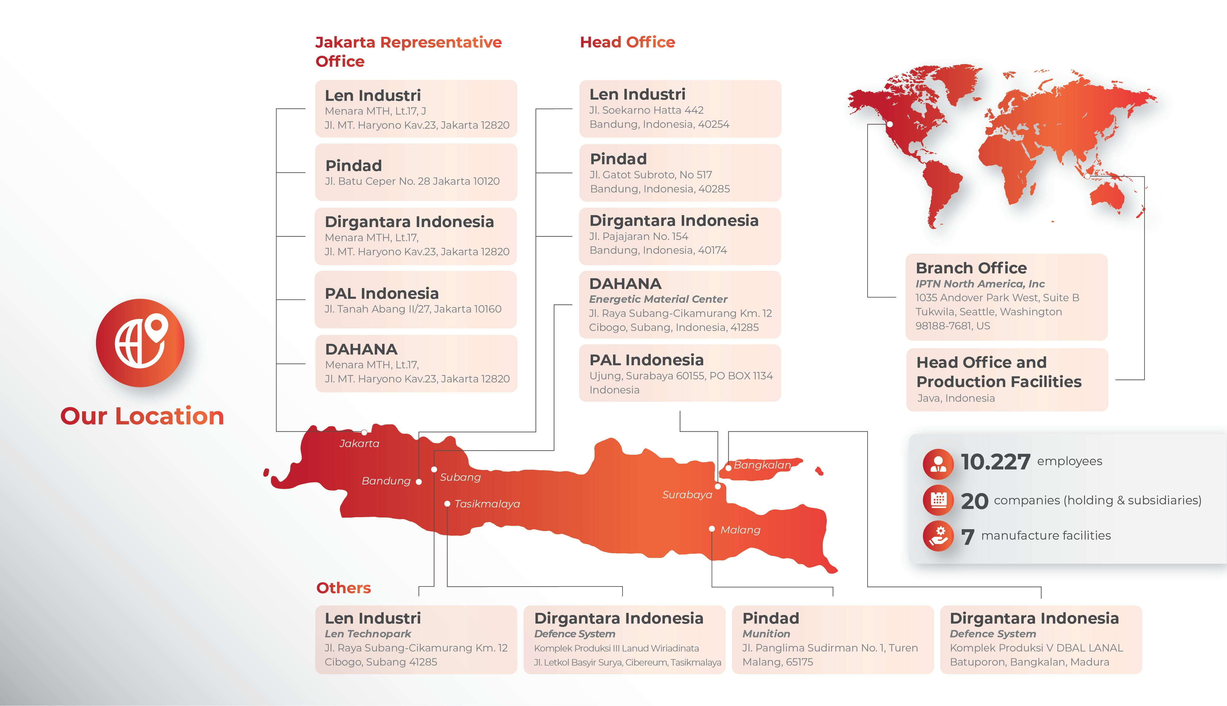

Slide 6
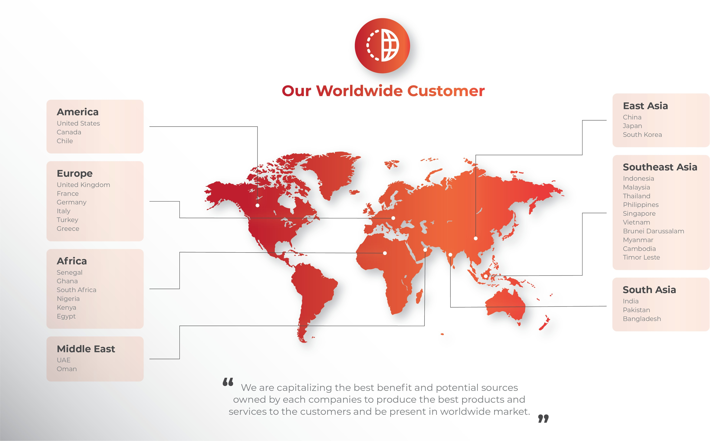

Slide 7
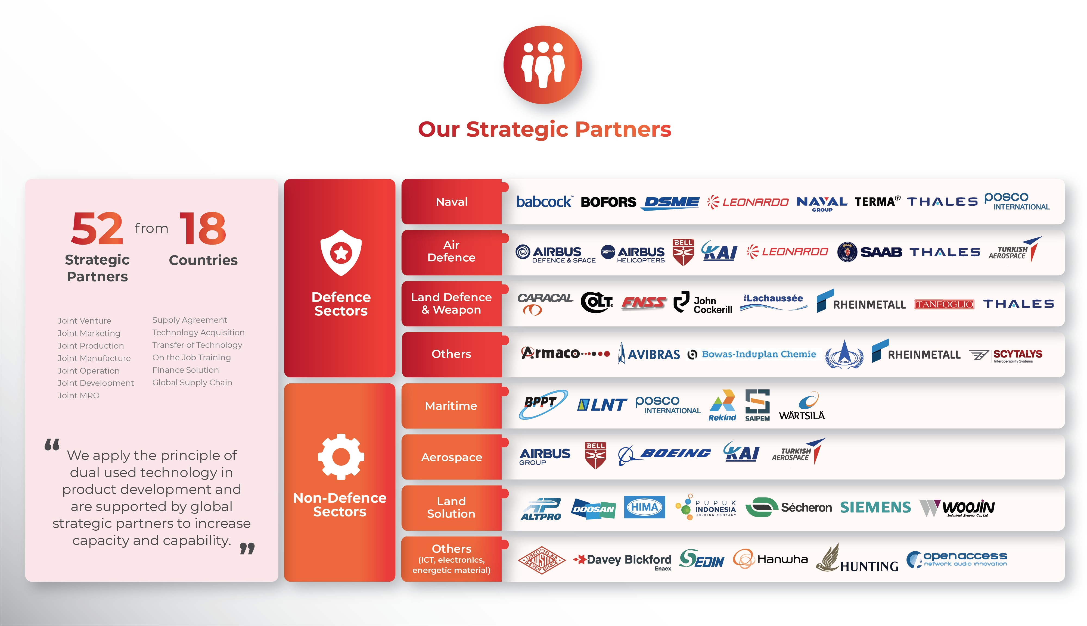

Slide 8

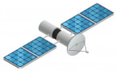



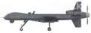




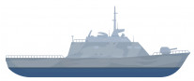



Holding in supporting the fulfillment of Defence Technology Modernization
SATELITE
FIGHTER JET
N219 - CN235 / N245 - KFX/IFX
DETECTION SYSTEM & INTEGRATED COMMUNICATIONA
AERIAL DRONE / UAV
C5ISR (Tactical Datalink, ICCS, Sistem NCW), Tactical Radio Communication
UAV Platform, Mission & Payload System
RADAR
MISSILE SYSTEM
Integrated Maritime Surveillance System,
Air Surveillance Radar, Radar GCI, Radar Cuaca, Over the horizon radar
BIG DATA
Cyber Security
MEDIUM TANK
COMBATANT SHIP
Medium Tank with Battle Management System
KCR 60M, OPV 90M, LPD / SSV, Frigate,
UNDERWATER DRONE
SUBMARINE SHIP
Nagapasa Class, Alugoro Class 1500 Ton

Slide 9
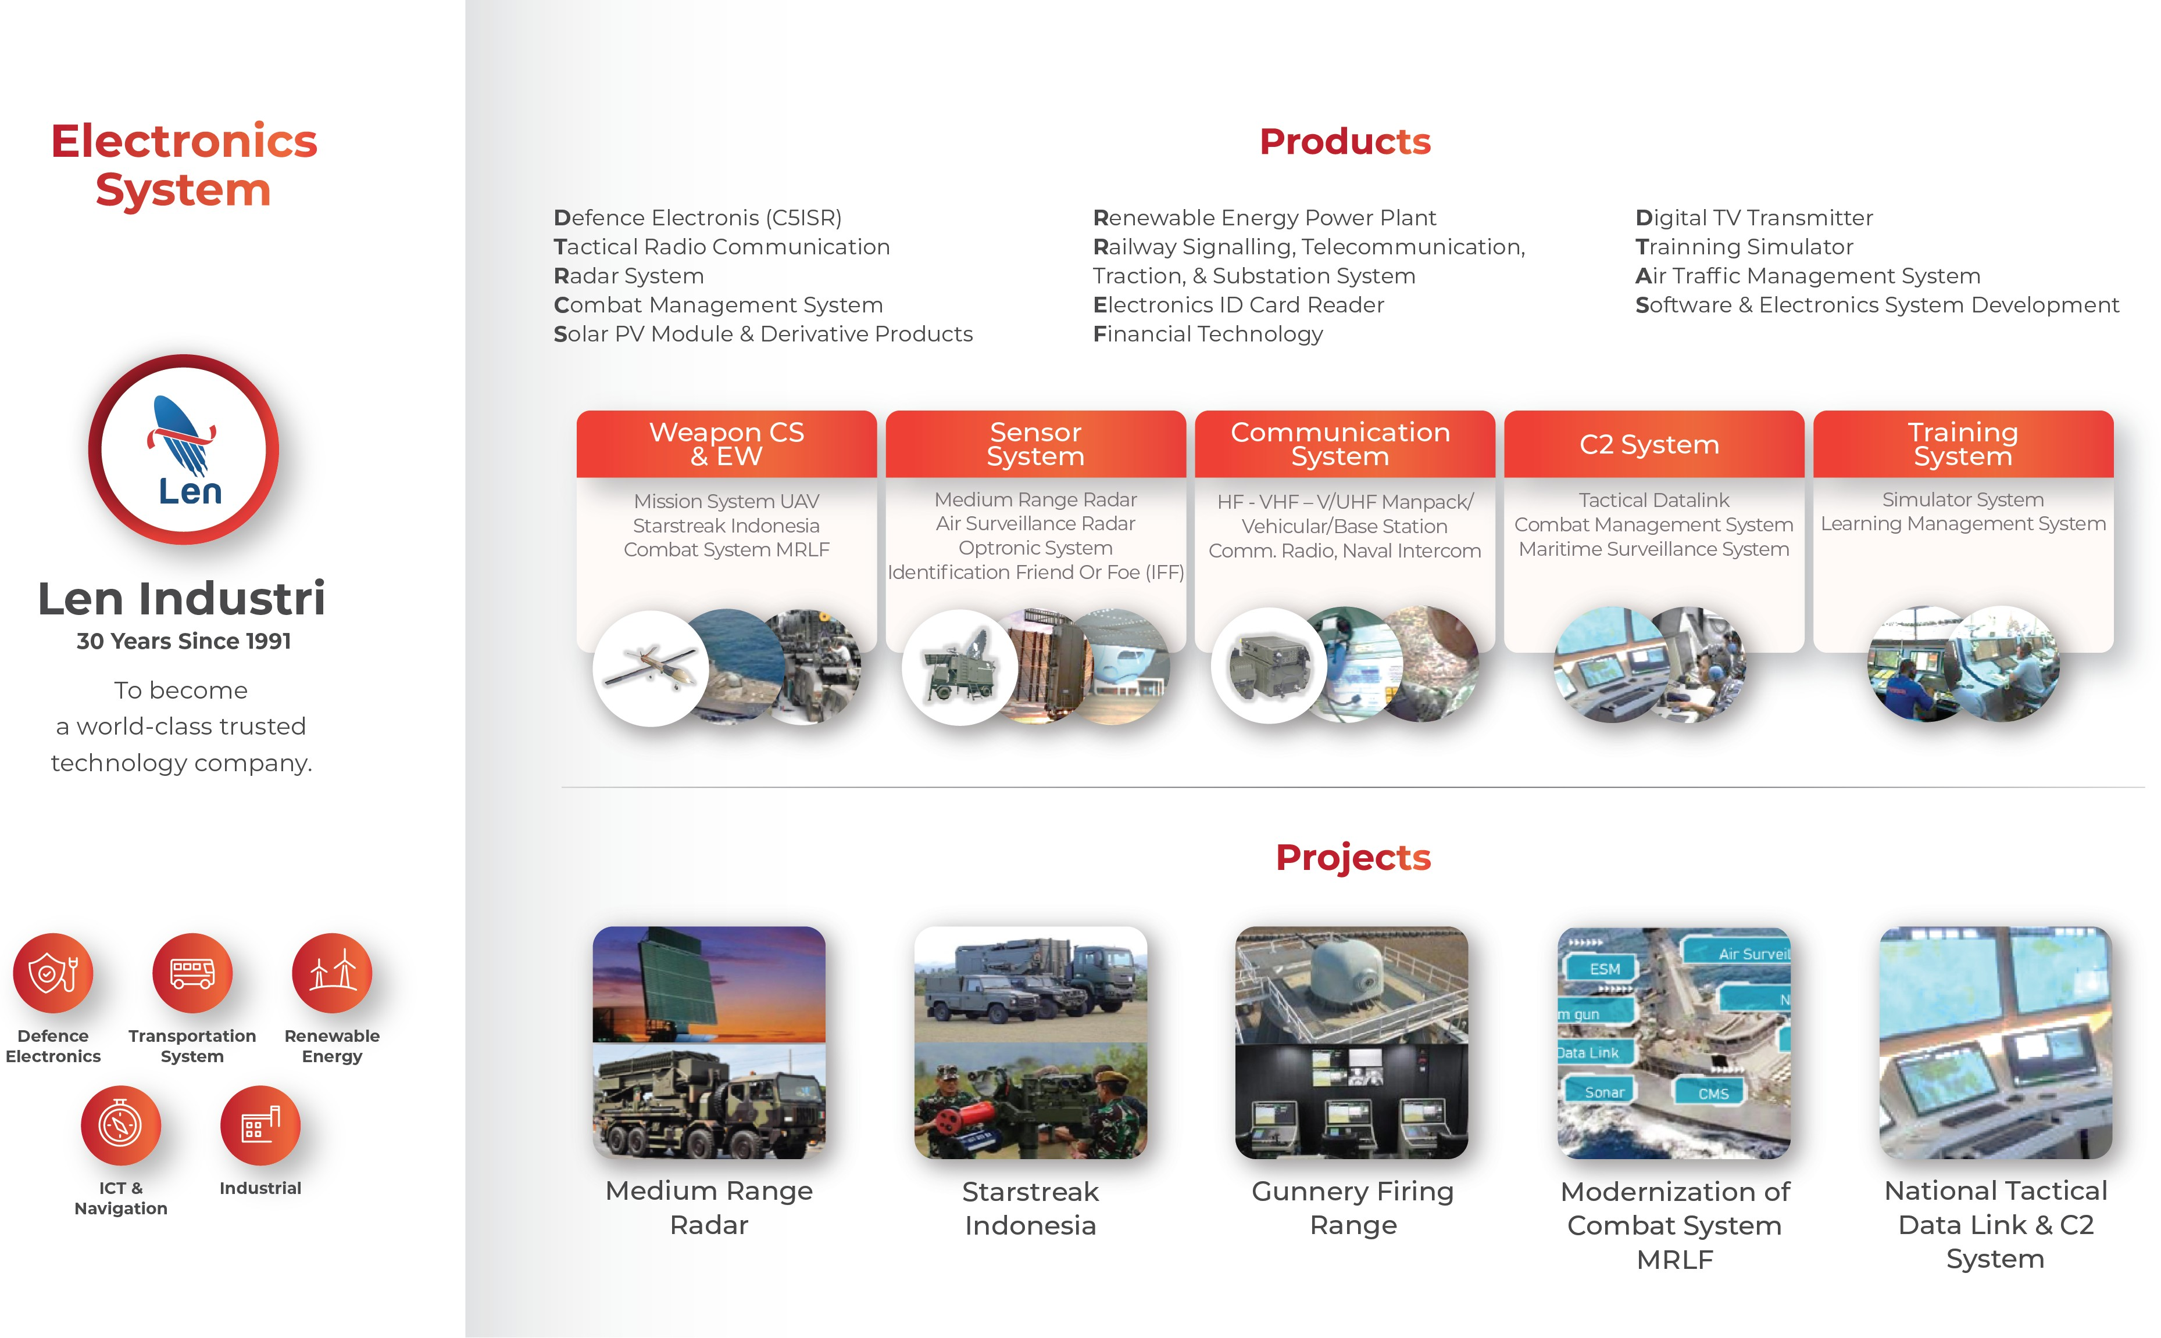

Slide 10
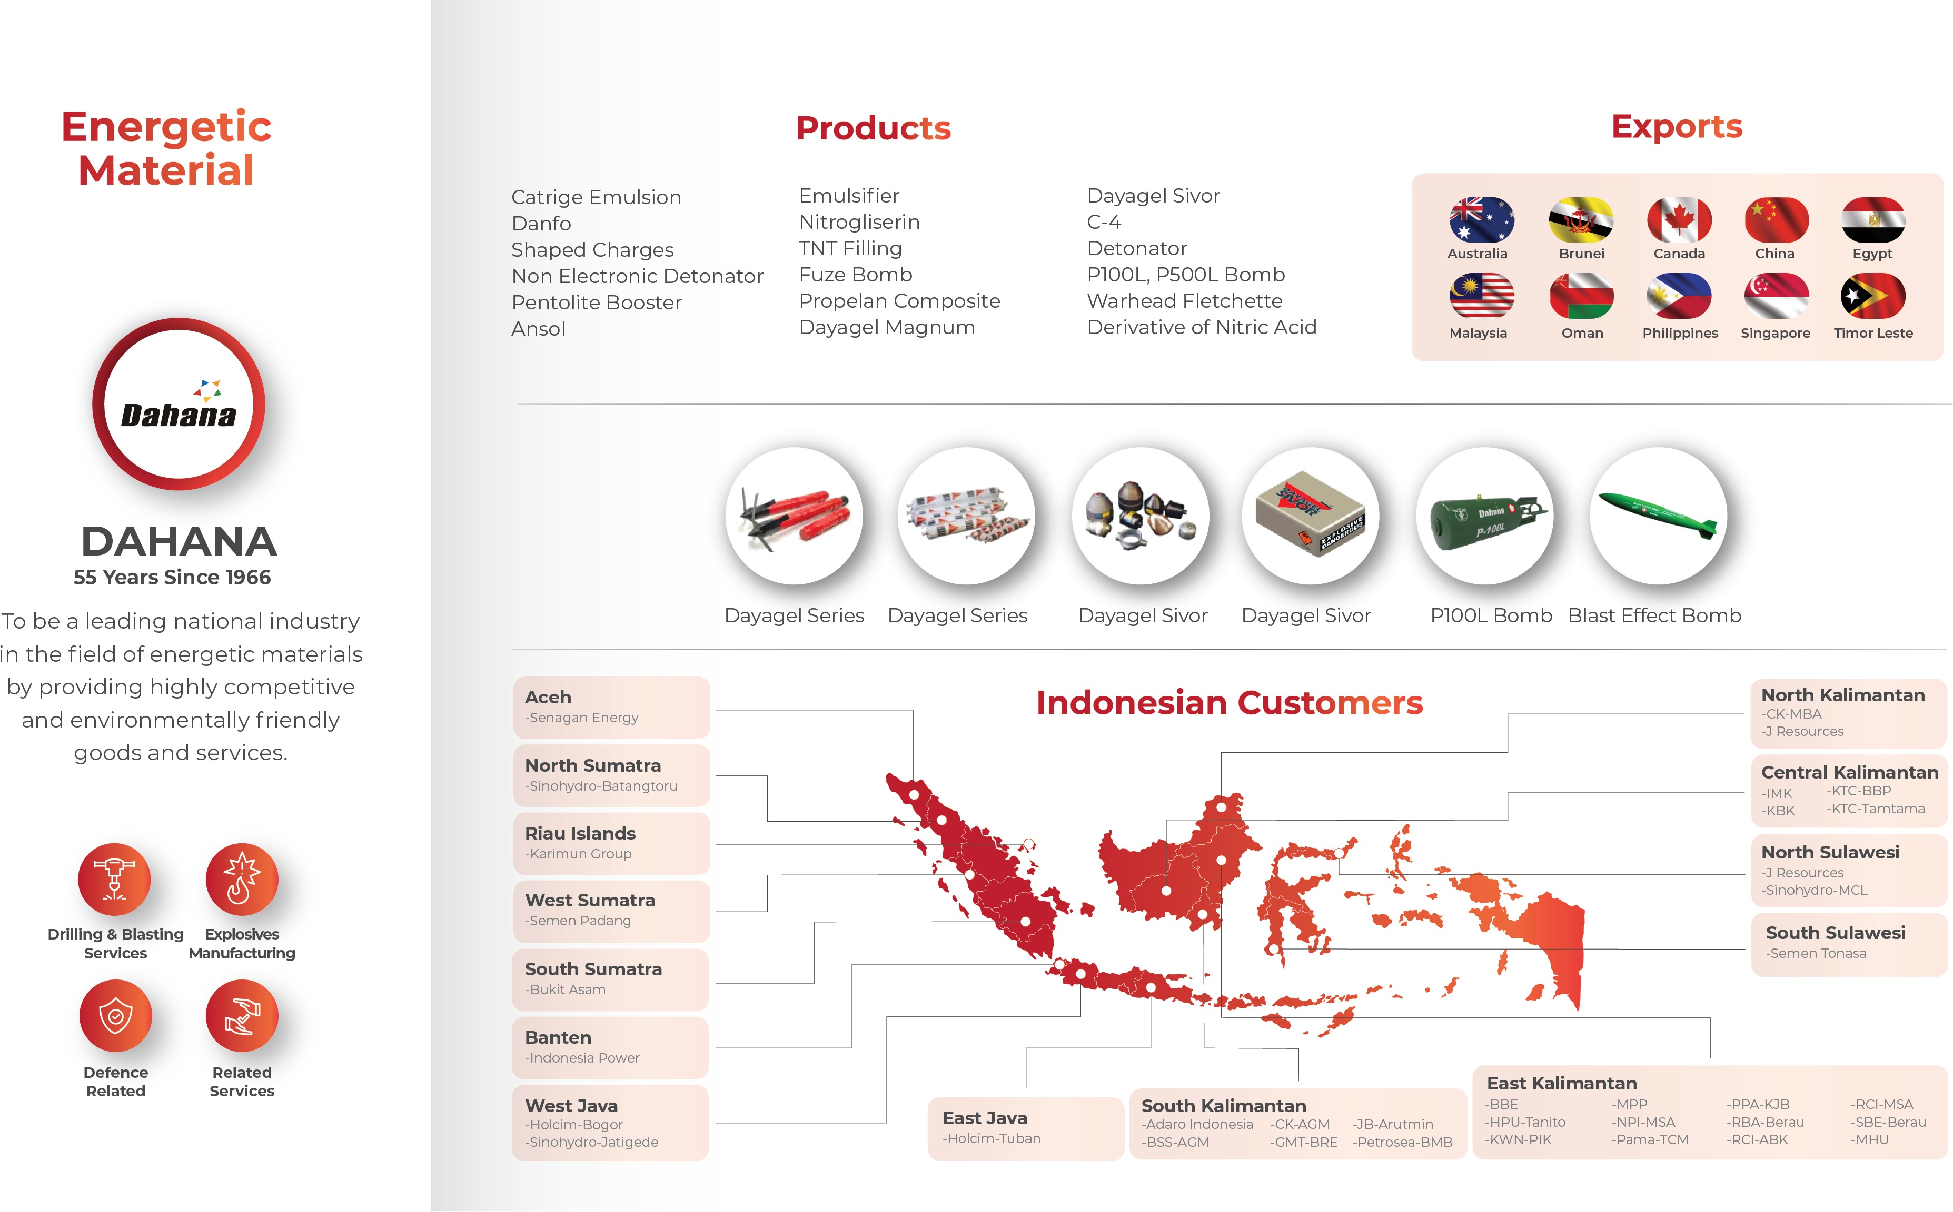

Slide 11
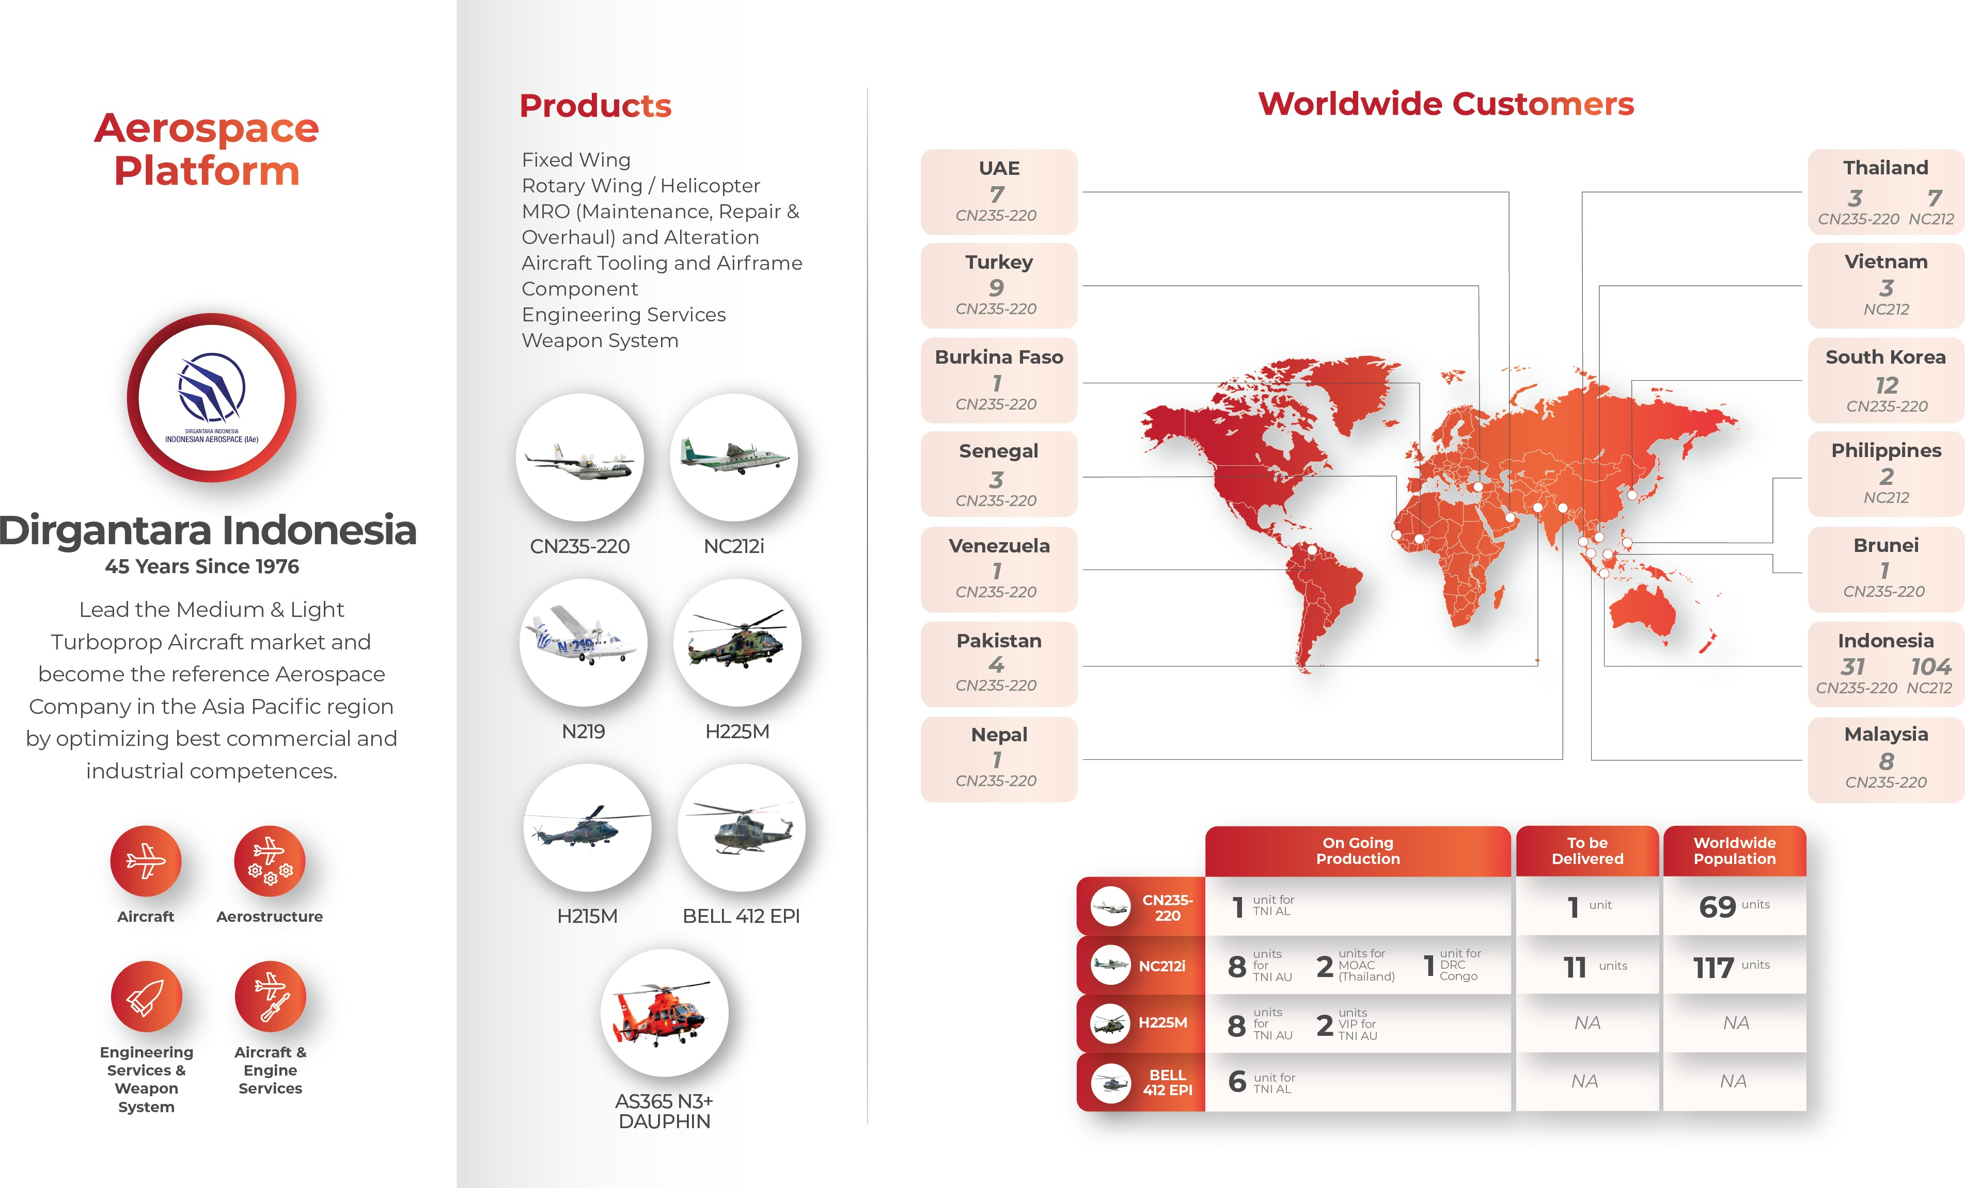

Slide 12
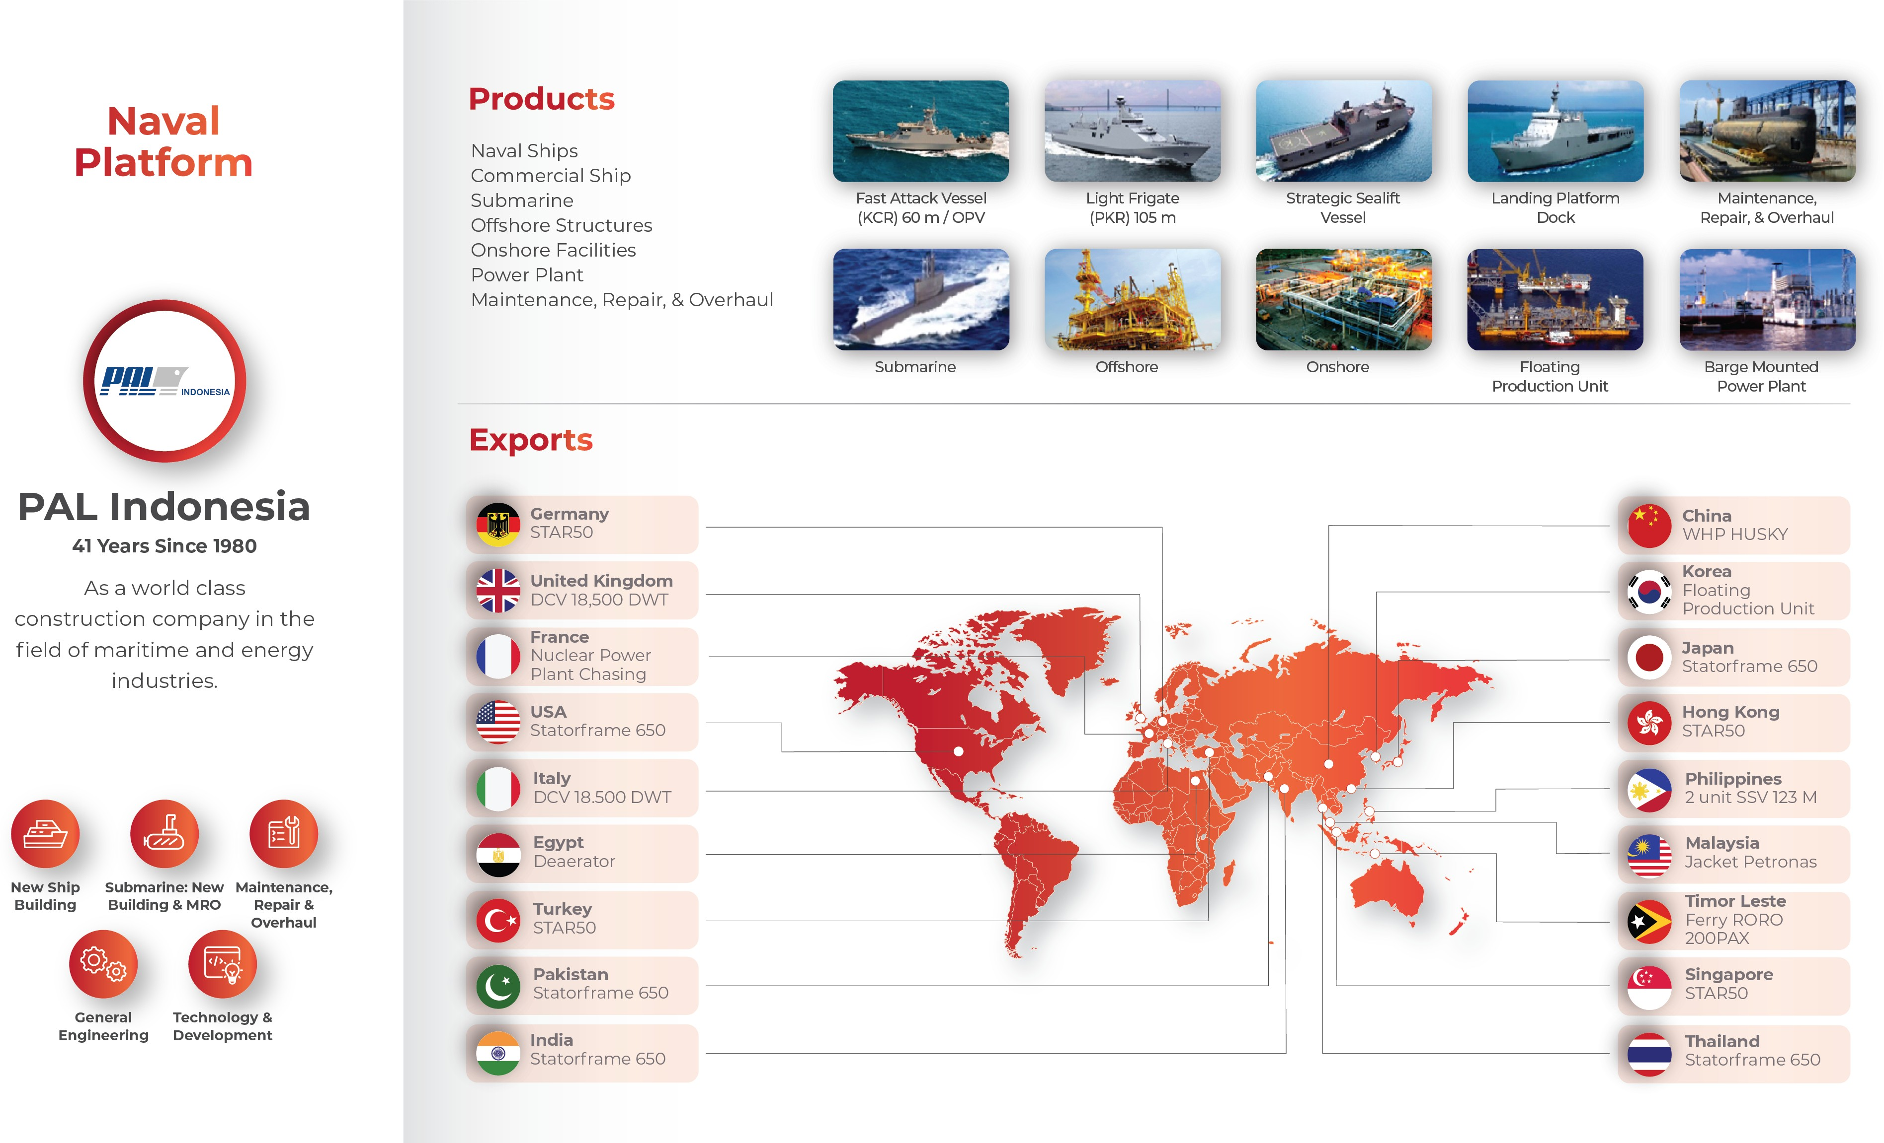

Slide 13
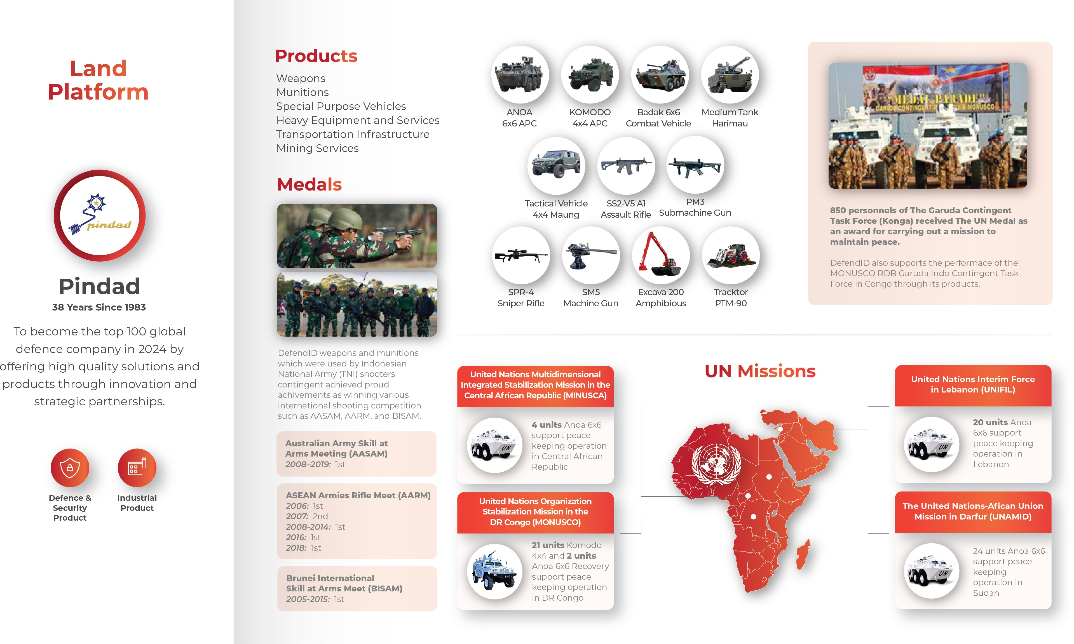

Slide 14

Objective
Building research and innovation collaborations that can strengthen core competencies, provide added value for dual used of technology and new technology
Building an integrated research and innovation roadmap for defense and manufacturing industry clusters
Building an ecosystem of defense and manufacturing industries that complement each other and can provide added value to increasing capabilities
Building strategies for dual-use character optimization, potential for national research collaborations,
Support the process and provide input for the formulation of government policies ( Policy Makers )
Establishing innovative business models based on research policies to provide significant and sustainable economies of scale
Recommend national defense and manufacturing industry governance and policy systems
INDONESIA DEFENSE & MANUFACTURING RESEARCH INSTITUTE
Vision
To become a world-class Research Institute that contributes to improving core competencies, maximizing strategic partnerships, and providing value-added solutions to support the independence and sustainability of the national defense and manufacturing industries
Mission
Building the capability of the Defense and Manufacturing Industry focuses on strengthening core competencies and maximizing strategic partnerships
Increasing ecosystem synergy to support the strengthening of defense & manufacturing technology and industries
Recommend sustainable defense and manufacturing industry policies through research policy and business model innovation

Slide 15
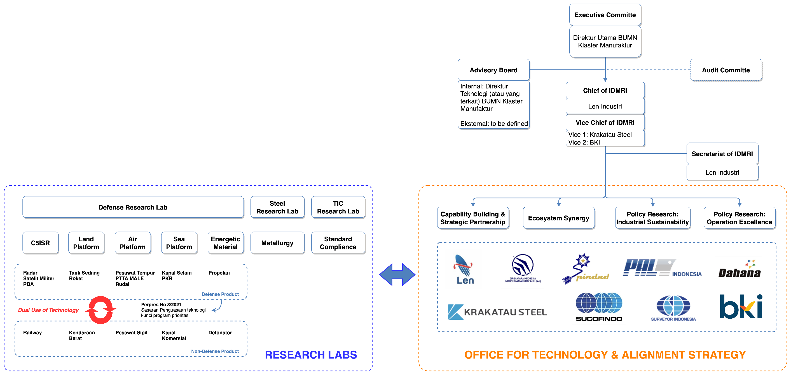
Structure
IDMRI Organization

Slide 16
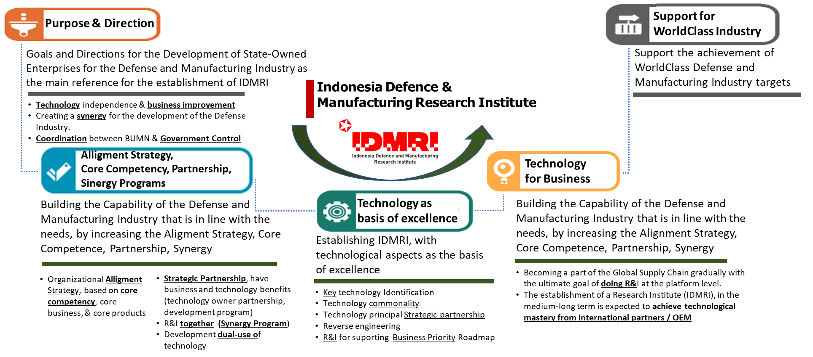
IDMRI Goals & Directions
The establishment of IDMRI as an effort to support the achievement of world-class manufacturing and defense

Slide 17
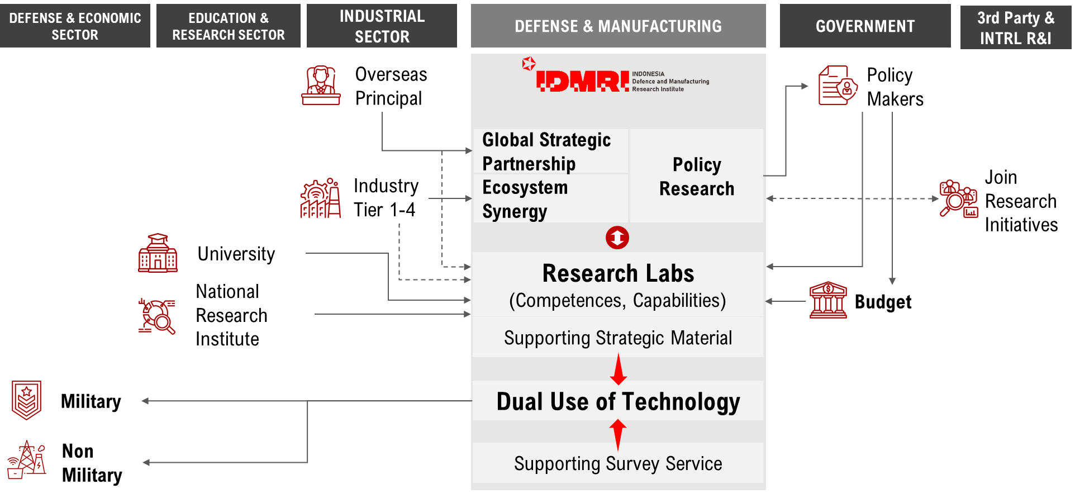
IDMRI Program Concept and Design

Slide 18



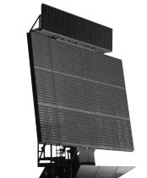
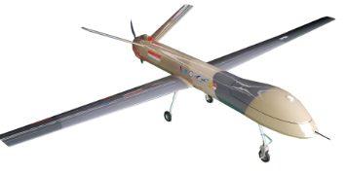
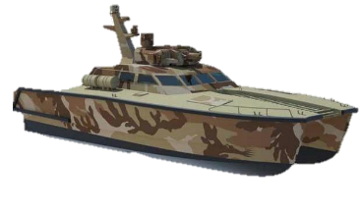
Research & Innovation with Key Technologies
Radar
Tank Boat
Rudal RN01-SS
UAV MALE
Government :
Balitbang Kemhan
LAPI ITB
Private Company:
PT Infoglobal Teknologi Semesta
PT Radar Telekomunikasi Indonesia
Government :
Ditjen Pothan Kemhan
Manufacturing Cluster SOE :
PT Len Industri (Persero)
BUMS:
PT Lundin Industry Invest
PT Hariff Daya Tunggal Engineering
Government :
Ditjen Pothan Kemhan
Manufacturing Cluster SOE :
PT Len Industri (Persero)
PT Dahana (Persero)
PT Pindad (Persero)
Private Company:
PT Mulia Laksana Adhitama
PT Aero Terrascan Indonesia
Government :
BRIN (BPPT, Ristek, LAPAN)
Balitbang Kemhan
Manufacturing Cluster SOE :
PT Len Industri (Persero)

Slide 19
